Slide 1
Nonparametric Estimation of Conditional Covariance Matrices
Advisor: Dr. Ge Zhao
Second Reader: Dr. Subhash Kochar
Presenter: Simon Lee
Fariboz Maseeh Department of Mathematics and Statistics
Portland State University
June 11, 2021

Slide 2
Overview
Introduction
Kernel Estimator and Regression Estimator
Estimation of Conditional Covariance Matrices
Application to Real Data
Conclusion

Slide 3
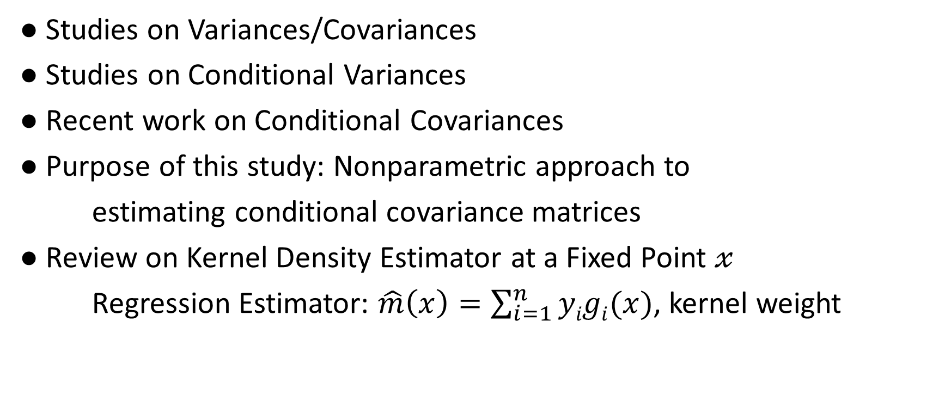
I. Introduction
● Studies on Variances/Covariances
● Studies on Conditional Variances
● Recent work on Conditional Covariances
● Purpose of this study: Nonparametric approach to
estimating conditional covariance matrices
● Review on Kernel Density Estimator at a Fixed Point $𝓍$
Regression Estimator: $\hat{m}\left(x\right)=\sum_{i=1}^{n}{yigi(x)}$, kernel weight

Slide 4
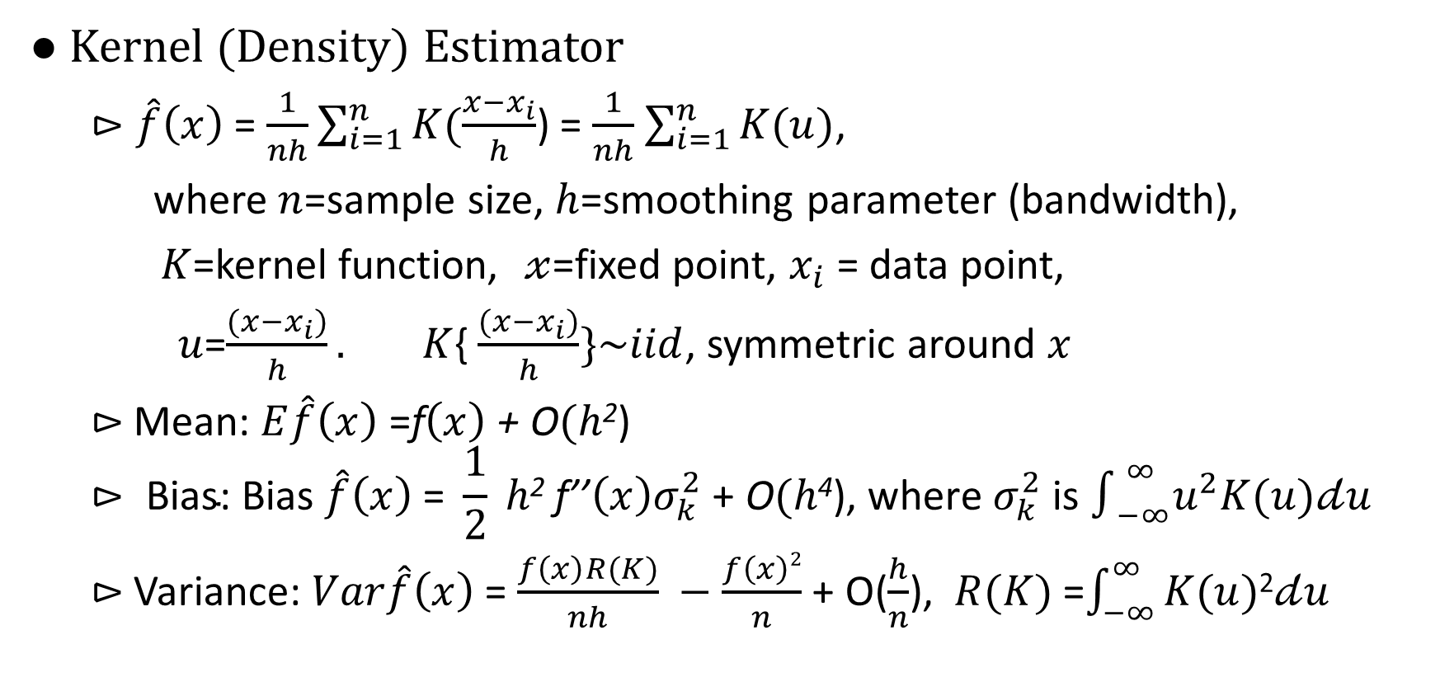
II. Kernel Estimator and Regression Estimator
● Kernel (Density) Estimator
$⊳\hat{f}\left(x\right)$ = $\frac{1}{nh}\sum_{i=1}^{n}{K(\frac{x−x_{i}}{h}}$) = $\frac{1}{nh}$ $\sum_{i=1}^{n}{K(u)}$,
where $n$=sample size, $h$=smoothing parameter (bandwidth),
$K$=kernel function, $𝓍$=fixed point, $x_{i}$ = data point,
$u$=$\frac{(x−x_{i})}{h}. K${ $\frac{(x−x_{i})}{h}\}\sim iid$, symmetric around $x$
$⊳$Mean: $E\hat{f}\left(x\right)$ =f$\left(x\right)$ + O$(h$²)
$$⊳ \text{Bias}\text{: }\text{Bias} \hat{f}\left(x\right)\text{ = }\frac{1}{2} h\text{2} \text{f}\text{’’}\left(x\right)σ_{k}^{2}\text{ + }\text{O}(h\text{4}\text{), }\text{where} σ_{k}^{2} \text{is} ∫_{−∞}^{∞}u^{2}K(u)𝒹u$$
$⊳$Variance: $Var\hat{f}\left(x\right)$ = $\frac{f\left(x\right)R(K)}{nh} −$ $\frac{f\left(x\right)2}{n}$ + O($\frac{h}{n}$), $R(K)$=$\int_{−∞}^{∞}{K(u)}$²$𝒹u$

Slide 5
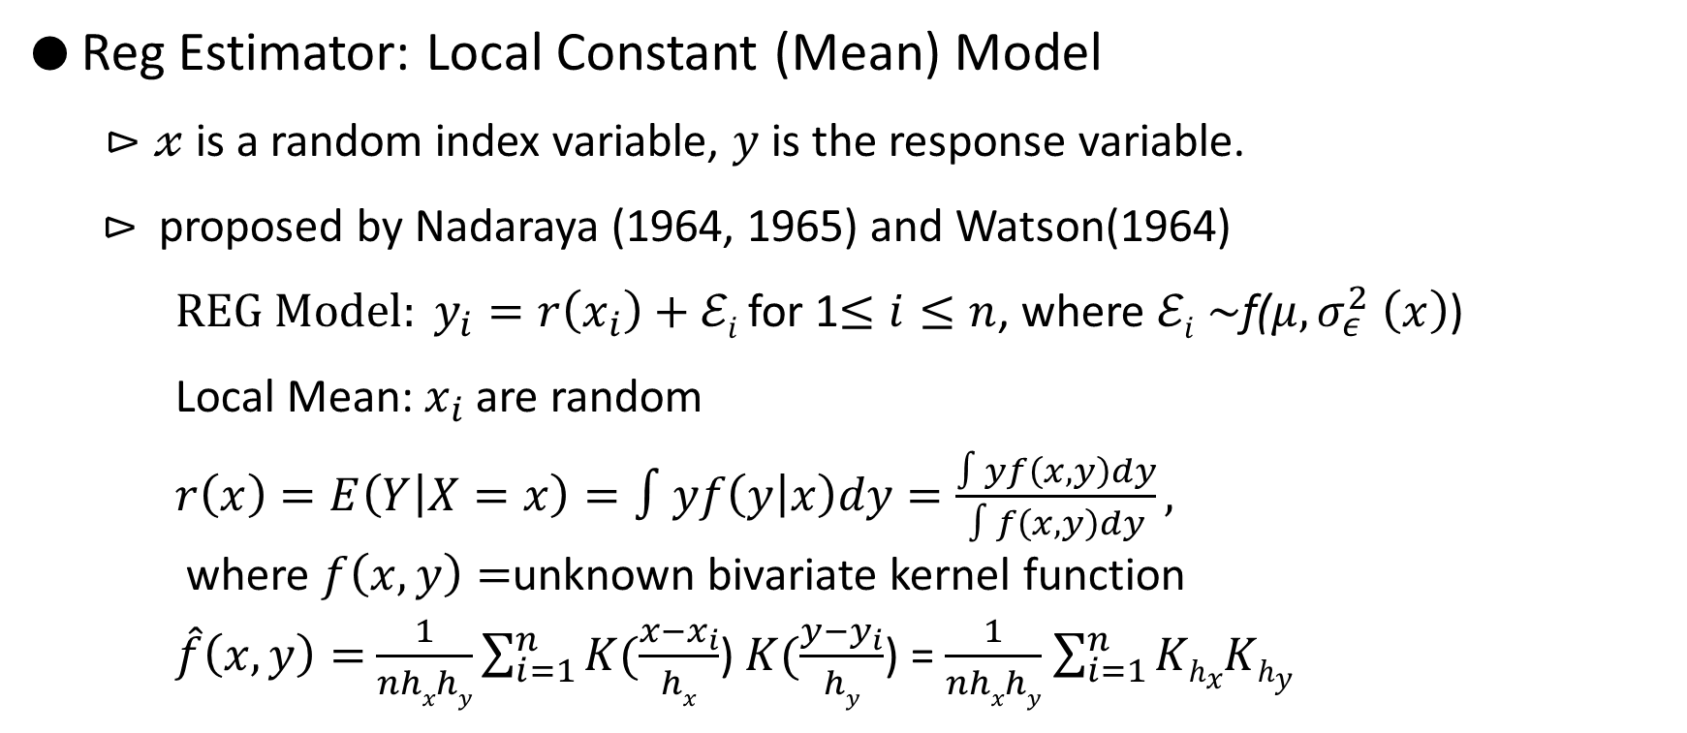
II. Kernel Estimator and Regression Estimator
● Reg Estimator: Local Constant (Mean) Model
$⊳𝓍$ is a random index variable, $y$ is the response variable.
$⊳$ proposed by Nadaraya (1964, 1965) and Watson(1964)
${REG Model: y}_{i}=r\left(x_{i}\right)+ℰi$ for 1$≤i≤n$, where $ℰi$ $\sim$f($μ, σ_{ε}^{2}$ $\left(x\right)$)
Local Mean: $x_{i}$ are random
$r\left(x\right)=E\left(Y | X=x\right)=∫yf\left(y | x\right)dy=\frac{∫yf\left(x,y\right)dy}{∫f\left(x,y\right)dy},$
where $f\left(x,y\right)=$unknown bivariate kernel function
$\hat{f}\left(x,y\right)=$ $\frac{1}{nhxhy}\sum_{i=1}^{n}{K(\frac{x−x_{i}}{hx}}$) $K(\frac{y−y_{i}}{hy}$) = $\frac{1}{nhxhy}$ $\sum_{i=1}^{n}{KhxKhy}$

Slide 6
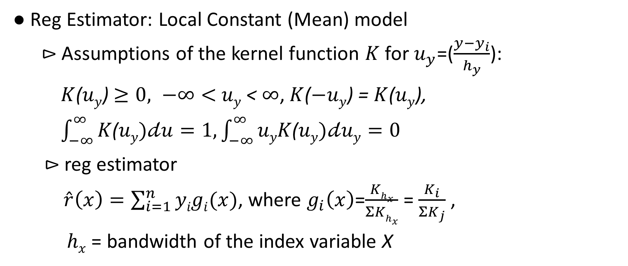
II. Kernel Estimator and Regression Estimator
● Reg Estimator: Local Constant (Mean) model
⊳ Assumptions of the kernel function $K$ for $u_{y}$=($\frac{y−y_{i}}{h_{y}}$):
$K$($uy$) $≥0, −∞<$ $uy$ < $∞$, $K$($−uy$) = $K$($uy$),
$\int_{−∞}^{∞}{K\text{(}uy})𝒹u=1, \int_{−∞}^{∞}{uyK\text{(}uy})𝒹uy=0$
$⊳$reg estimator
$\hat{r}\left(x\right)=\sum_{i=1}^{n}{yigi(x)}$, where $g_{i}\left(x\right)$=$\frac{Khx}{ΣKhx}$ = $\frac{K_{i}}{{ΣK}_{j}}$ ,
$hx$ = bandwidth of the index variable X

Slide 7
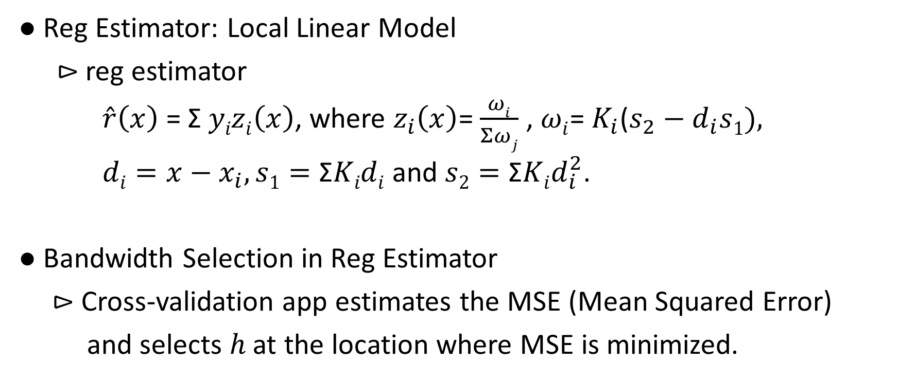
II. Kernel Estimator and Regression Estimator
● Reg Estimator: Local Linear Model
$⊳$ reg estimator
$\hat{r}\left(x\right)$ = Σ $yizi\left(x\right)$, where $z_{i}\left(x\right)$= $\frac{ωi}{Σωj}$ , $ωi$= $K_{i}$($s_{2}−d_{i}s1),$
$di=x−x_{i}, s1=\text{Σ}\text{K}idi$ and $s2=\text{Σ}Kid_{i}^{2}$.
● Bandwidth Selection in Reg Estimator
⊳ Cross-validation app estimates the MSE (Mean Squared Error)
and selects ℎ at the location where MSE is minimized.

Slide 8
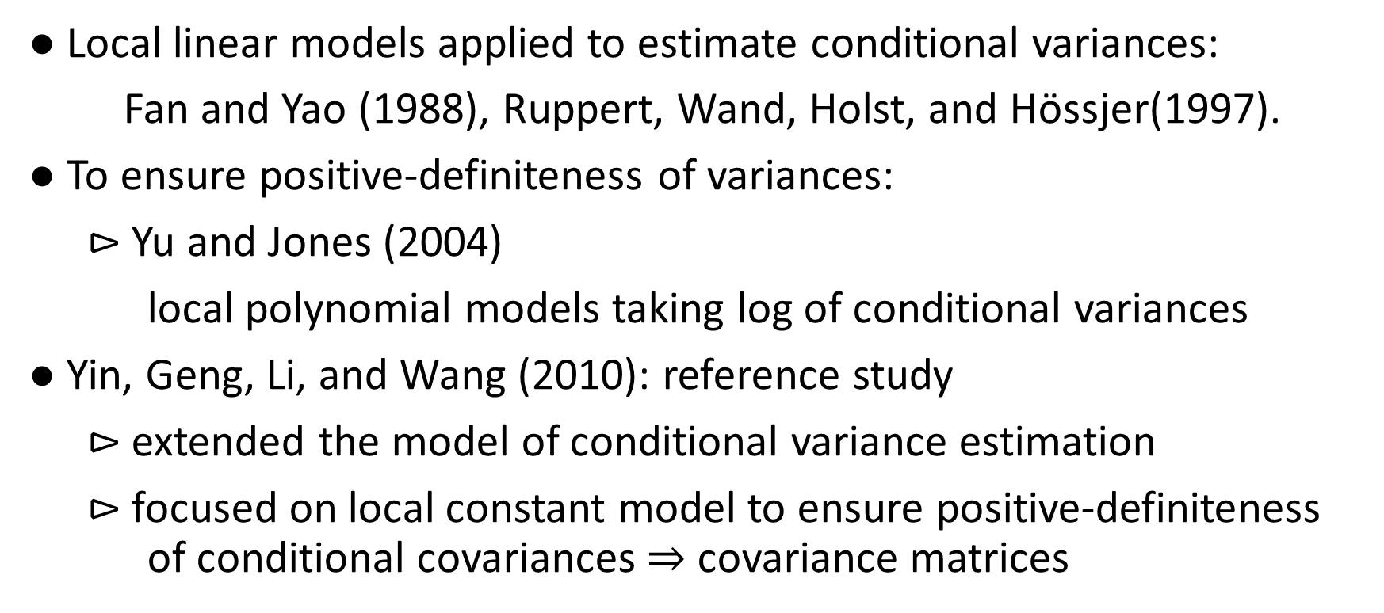
III. Estimation of Conditional Covariance Matrices
● Local linear models applied to estimate conditional variances:
Fan and Yao (1988), Ruppert, Wand, Holst, and Hӧssjer(1997).
● To ensure positive-definiteness of variances:
$⊳$Yu and Jones (2004)
local polynomial models taking log of conditional variances
● Yin, Geng, Li, and Wang (2010): reference study
$⊳$extended the model of conditional variance estimation
$⊳$focused on local constant model to ensure positive-definiteness of conditional covariances $⇒$ covariance matrices

Slide 9
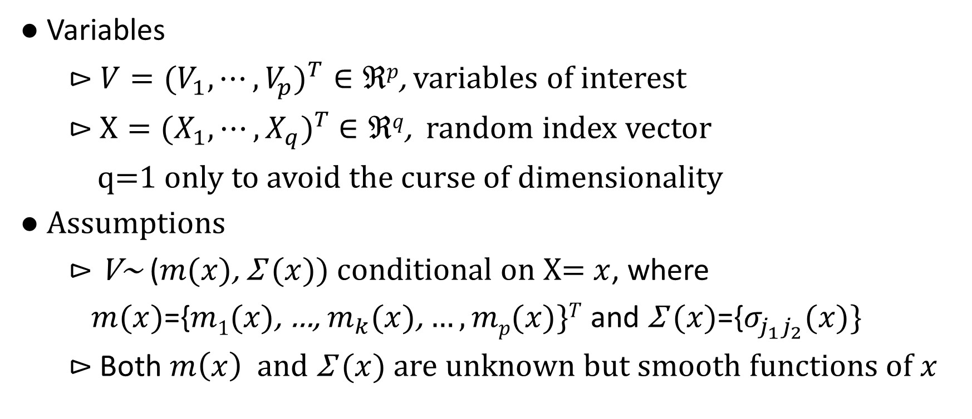
III. Estimation of Conditional Covariance Matrices
● Variables
$⊳$ $V=({V_{1},⋯,V_{p})}^{T}∈ℜp$, variables of interest
$⊳$ $X=({X_{1},⋯,X_{q})}^{T}$ $∈ℜq$, random index vector
q=1 only to avoid the curse of dimensionality
● Assumptions
$⊳$V~ ($m(x)$, Σ $(x)$) conditional on X= $x$, where
$m(x)$={$m1(x)$, …, $m_{k}(x)$, $…,mp(x)\}T$ and Σ $(x)$={$σ_{j_{1}j_{2}}(x)\}$
$⊳$Both $m\left(x\right)$ and Σ $(x)$ are unknown but smooth functions of $x$

Slide 10
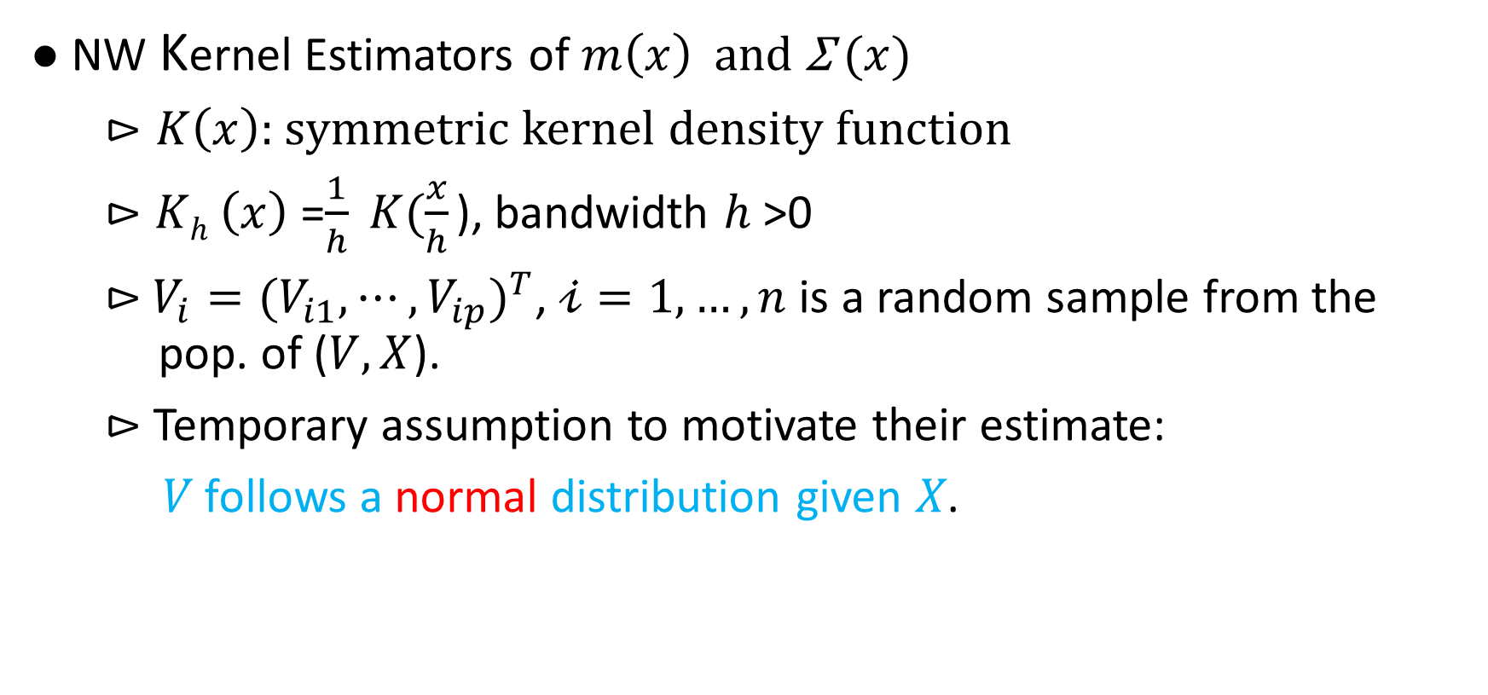
III. Estimation of Conditional Covariance Matrices
● NW Kernel Estimators of $m\left(x\right)$ and Σ $(x)$
$⊳K\left(x\right)$: symmetric kernel density function
$⊳Kh$ $\left(x\right)$ =$\frac{1}{h} K(\frac{x}{h}$ ), bandwidth $h$>0
$⊳$ $V_{i}=({V_{i1},⋯,V_{ip})}^{T}$, $𝒾=1, …, n$ is a random sample from the pop. of ($V,X$).
$⊳$ Temporary assumption to motivate their estimate:
𝑉 follows a normal distribution given 𝑋.

Slide 11
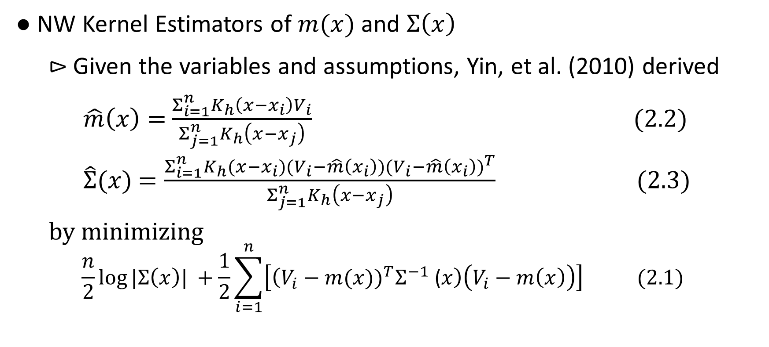
III. Estimation of Conditional Covariance Matrices
● NW Kernel Estimators of $m(x)$ and $Σ\left(x\right)$
$⊳$ Given the variables and assumptions, Yin, et al. (2010) derived
$\hat{m}\left(x\right)=$ $\frac{Σ_{i=1}^{n}K_{h}\left({x−x}_{i}\right)V_{i}}{Σ_{j=1}^{n}K_{h}\left({x−x}_{j}\right)}$ (2.2)
$\hat{Σ}(x)$ $=\frac{Σ_{i=1}^{n}K_{h}({{x−x}_{i})(V_{i}−\hat{m}\left(x_{i}\right))(V_{i}−\hat{m}\left(x_{i}\right))}^{T}}{Σ_{j=1}^{n}K_{h}\left({x−x}_{j}\right)}$ (2.3)
by minimizing
$$\frac{n}{2}\log{|Σ\left(x\right)| }+\frac{1}{2}\sum_{i=1}^{n}{\left[\left({V_{i}−m(x))}^{T}Σ^{−1} \text{(}x\right)\left(V_{i}−m\left(x\right)\right)\right] (2.1)}$$

Slide 12
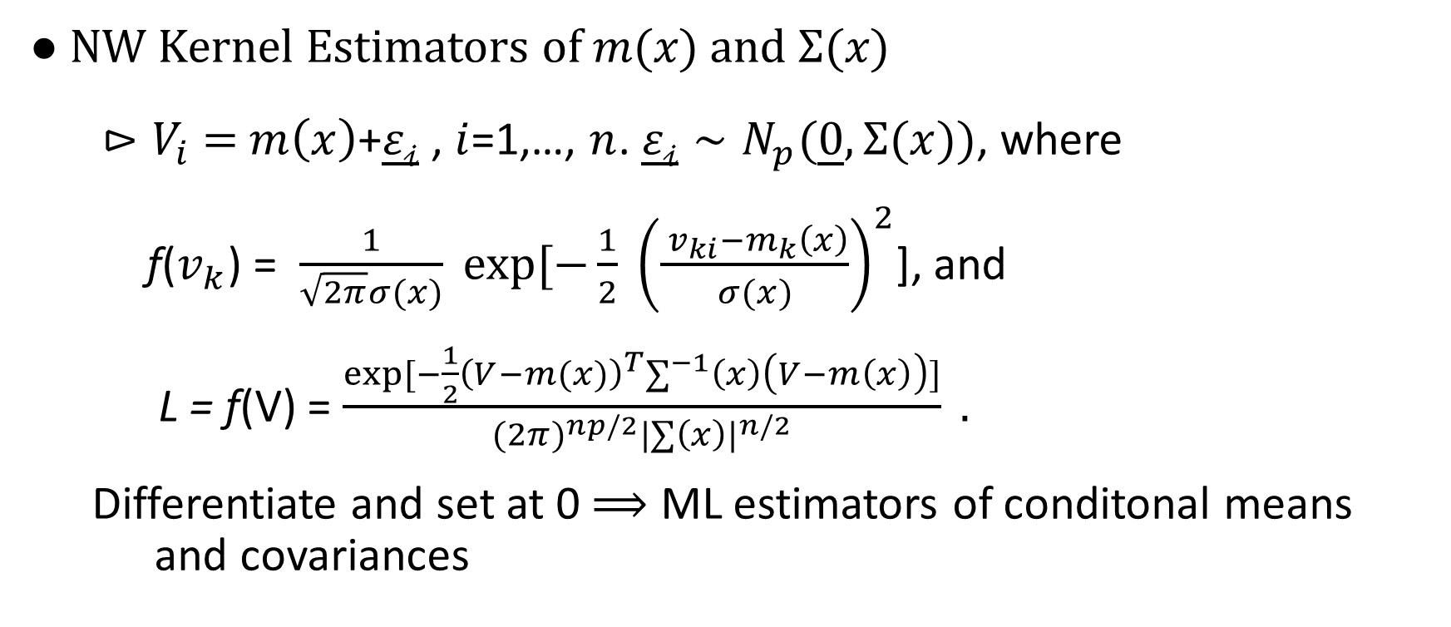
III. Estimation of Conditional Covariance Matrices
● NW Kernel Estimators of 𝑚(𝑥) and Σ(𝑥)
$⊳V_{i}$ $=$ $m\left(x\right)$+$\underline{ε𝒾}$ , $i$=1,…, $n$. $\underline{ε𝒾}∼N_{p}(\underline{0},\text{Σ}\text{(}\text{x}))$, where
f($v_{k}$) = $\frac{1}{\sqrt{2π}σ(x)} exp[−\frac{1}{2} {\left(\frac{{ v}_{ki}−m_{k}\left(x\right)}{σ(x)}\right)}^{2}$], and
L = f(V) = $\frac{exp⁡[−\frac{1}{2}{\left(V−m(x)\right)}^{T}∑^{−1}\left(x\right)\left(V−m\left(x\right)\right)]}{{(2π)}^{np/2}{|∑\left(x\right)|}^{n/2}} .$
Differentiate and set at 0 $⟹$ ML estimators of conditonal means and covariances

Slide 13
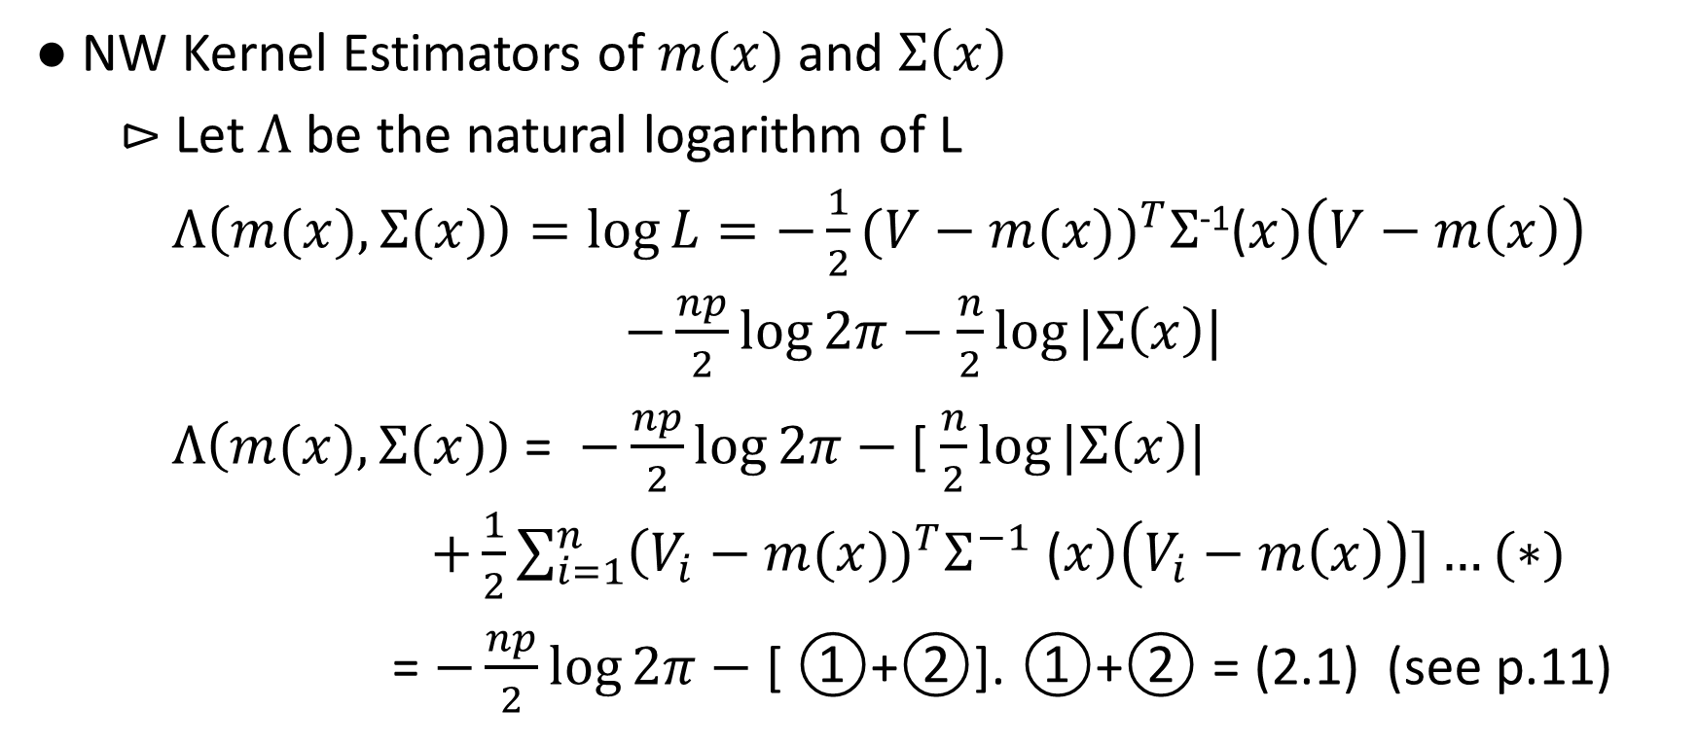
III. Estimation of Conditional Covariance Matrices
● NW Kernel Estimators of $m(x)$ and $Σ\left(x\right)$
$⊳$ Let $Λ$ be the natural logarithm of L
$Λ\left(m(x), Σ(x)\right)=\log{L=−\frac{1}{2}}({V−m(x))}^{T}Σ$⁻¹($x)\left(V−m\left(x\right)\right)$
$−\frac{np}{2}\log{2π−}$ $\frac{n}{2}\log{|Σ\left(x\right)| }$
$Λ\left(m(x), Σ(x)\right)$ = $−\frac{np}{2}\log{2π−}$ [ $\frac{n}{2}\log{|Σ\left(x\right)| }$
$+\frac{1}{2}\sum_{i=1}^{n}{\left({V_{i}−m(x))}^{T}Σ^{−1} \text{(}x\right)\left(V_{i}−m\left(x\right)\right)]…(∗)}$
= $−\frac{np}{2}\log{2π−}$ [ ①+②]. ①+② = (2.1) (see p.11)

Slide 14
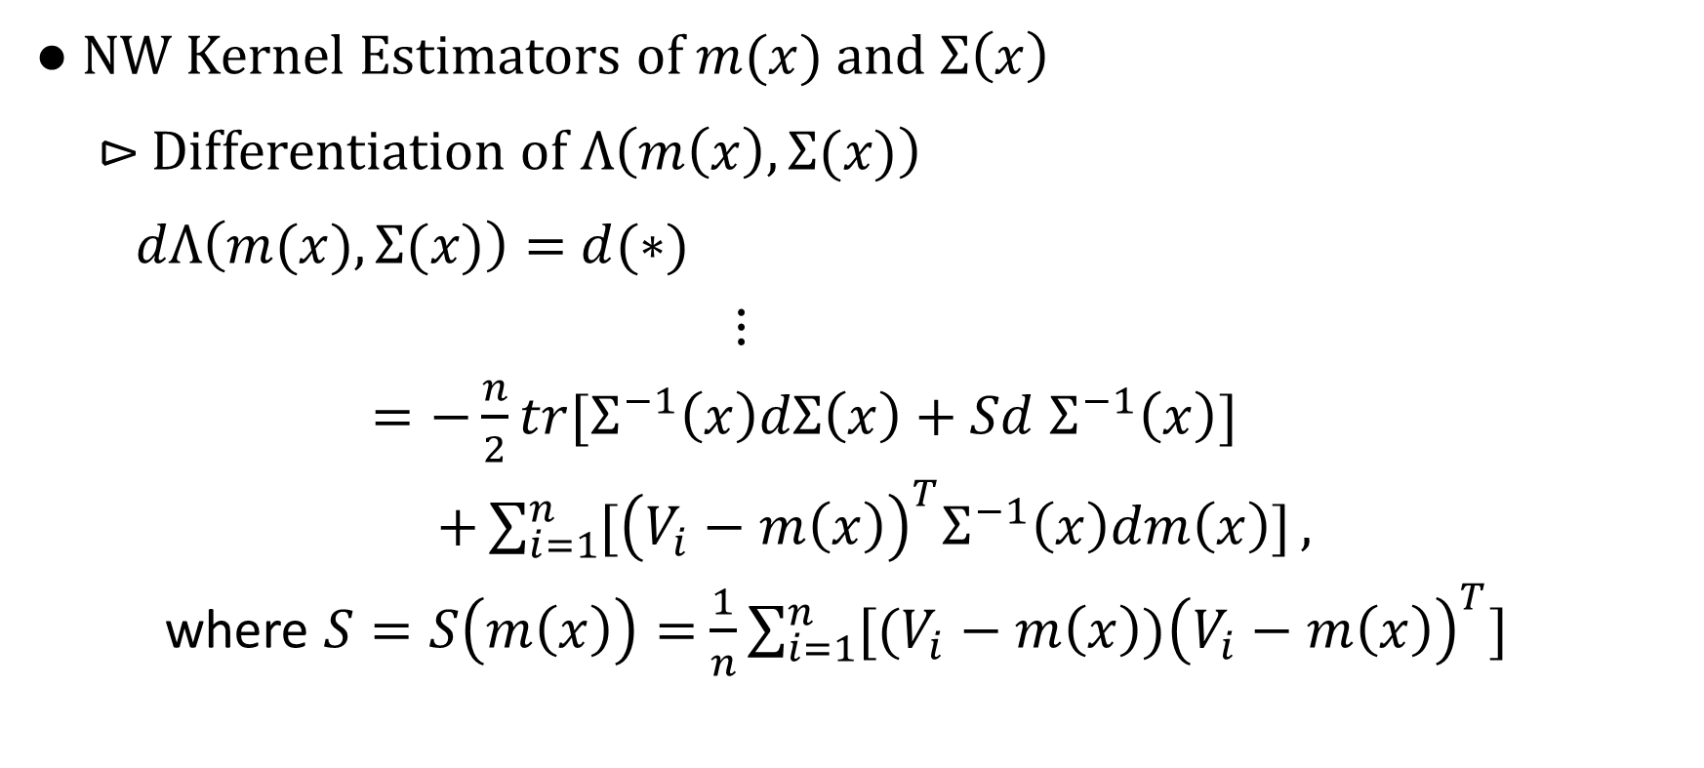
III. Estimation of Conditional Covariance Matrices
● NW Kernel Estimators of $m(x)$ and $Σ\left(x\right)$
$⊳$ Differentiation of $Λ\left(m\left(x\right),Σ(x)\right)$
$dΛ\left(m(x),Σ(x)\right)=$ $d(∗)$
$⋮$
$=−\frac{n}{2}tr[Σ^{−1}\left(x\right)dΣ\left(x\right)+Sd$ $Σ^{−1}\left(x\right)]$
$+\sum_{i=1}^{n}{{[\left(V_{i}−m\left(x\right)\right)}^{T}Σ^{−1}\left(x\right)dm\left(x\right)]},$
where $S=S\left(m\left(x\right)\right)=$ $\frac{1}{n}\sum_{i=1}^{n}{{[(V_{i}−m\left(x\right))\left(V_{i}−m\left(x\right)\right)}^{T}]}$

Slide 15
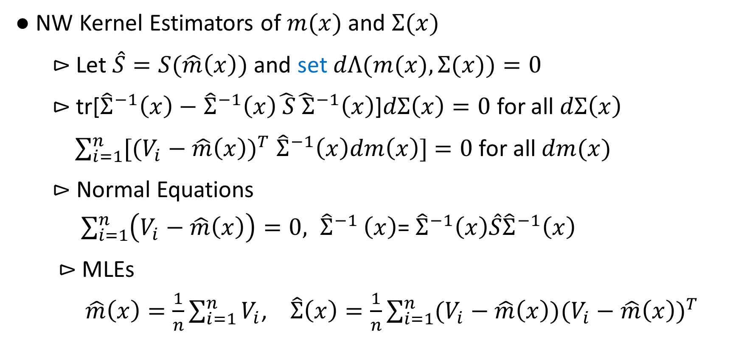
III. Estimation of Conditional Covariance Matrices
● NW Kernel Estimators of $m(x)$ and $Σ(x)$
$⊳$Let $\hat{S}=S(\hat{m}\left(x\right))$ and set $dΛ(m(x),Σ(x))=0$
$⊳$tr[${\hat{Σ}}^{−1}\left(x\right)−$ ${\hat{Σ}}^{−1}\left(x\right)\hat{ S}{\hat{ Σ}}^{−1}\left(x\right)$]$dΣ\left(x\right)=0$ for all $dΣ\left(x\right)$
$\sum_{i=1}^{n}{{[(V_{i}−\hat{m}\left(x\right))}^{T} {\hat{Σ}}^{−1}\left(x\right)dm\left(x\right)]}$ $=0$ for all $dm(x)$
$⊳$ Normal Equations
$\sum_{i=1}^{n}{\left(V_{i}−\hat{m}\left(x\right)\right)}=0{, \hat{Σ}}^{−1}\left(x\right)$= ${\hat{Σ}}^{−1}\left(x\right)\hat{S}{\hat{Σ}}^{−1}\left(x\right)$
$⊳$MLEs
$\hat{m}\left(x\right)=\frac{1}{n}\sum_{i=1}^{n}{V_{i}}$, $\hat{Σ}\left(x\right)=\frac{1}{n}\sum_{i=1}^{n}{{(V_{i}−\hat{m}\left(x\right))(V_{i}−\hat{m}\left(x\right))}^{T}}$

Slide 16
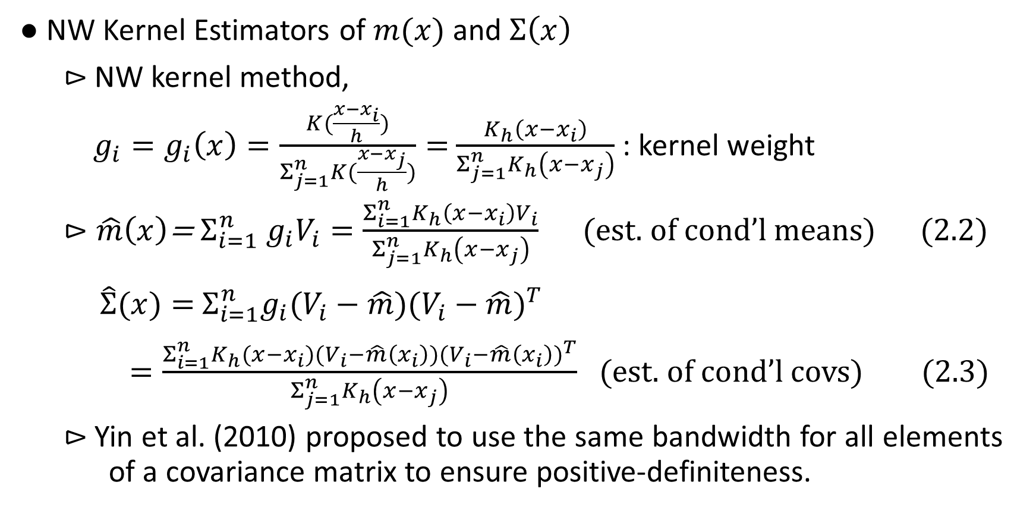
III. Estimation of Conditional Covariance Matrices
● NW Kernel Estimators of $m(x)$ and $Σ\left(x\right)$
$⊳$NW kernel method,
$g_{i}=g_{i}\left(x\right)=\frac{K(\frac{{x−x}_{i}}{h})}{Σ_{j=1}^{n}K(\frac{{x−x}_{j}}{h})}=$ $\frac{K_{h}\left({x−x}_{i}\right)}{Σ_{j=1}^{n}K_{h}\left({x−x}_{j}\right)}$ : kernel weight
$⊳\hat{m}\left(x\right)$= $Σ_{i=1}^{n}$ $g_{i}V_{i}=\frac{Σ_{i=1}^{n}K_{h}\left({x−x}_{i}\right)V_{i}}{Σ_{j=1}^{n}K_{h}\left({x−x}_{j}\right)}$ (est. of cond’l means) (2.2)
$\hat{Σ}(x)=$ $Σ_{i=1}^{n}{g_{i}(V_{i}−\hat{m})(V_{i}−\hat{m})}^{T}$
$=\frac{Σ_{i=1}^{n}K_{h}({{x−x}_{i})(V_{i}−\hat{m}\left(x_{i}\right))(V_{i}−\hat{m}\left(x_{i}\right))}^{T}}{Σ_{j=1}^{n}K_{h}\left({x−x}_{j}\right)}$ (est. of cond’l covs) (2.3)
$⊳$Yin et al. (2010) proposed to use the same bandwidth for all elements of a covariance matrix to ensure positive-definiteness.

Slide 17
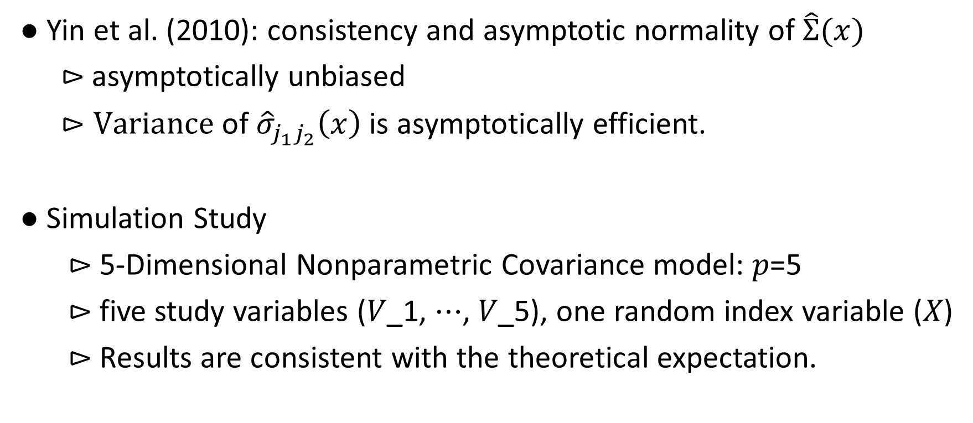
III. Estimation of Conditional Covariance Matrices
● Yin et al. (2010): consistency and asymptotic normality of $\hat{Σ}(x)$
$⊳$ asymptotically unbiased
$⊳Variance$ of ${\hat{σ}}_{j_{1}j_{2}}\left(x\right)$ is asymptotically efficient.
● Simulation Study
⊳ 5-Dimensional Nonparametric Covariance model: 𝑝=5
⊳ five study variables (𝑉_1, ⋯, 𝑉_5), one random index variable (𝑋)
⊳ Results are consistent with the theoretical expectation.

Slide 18
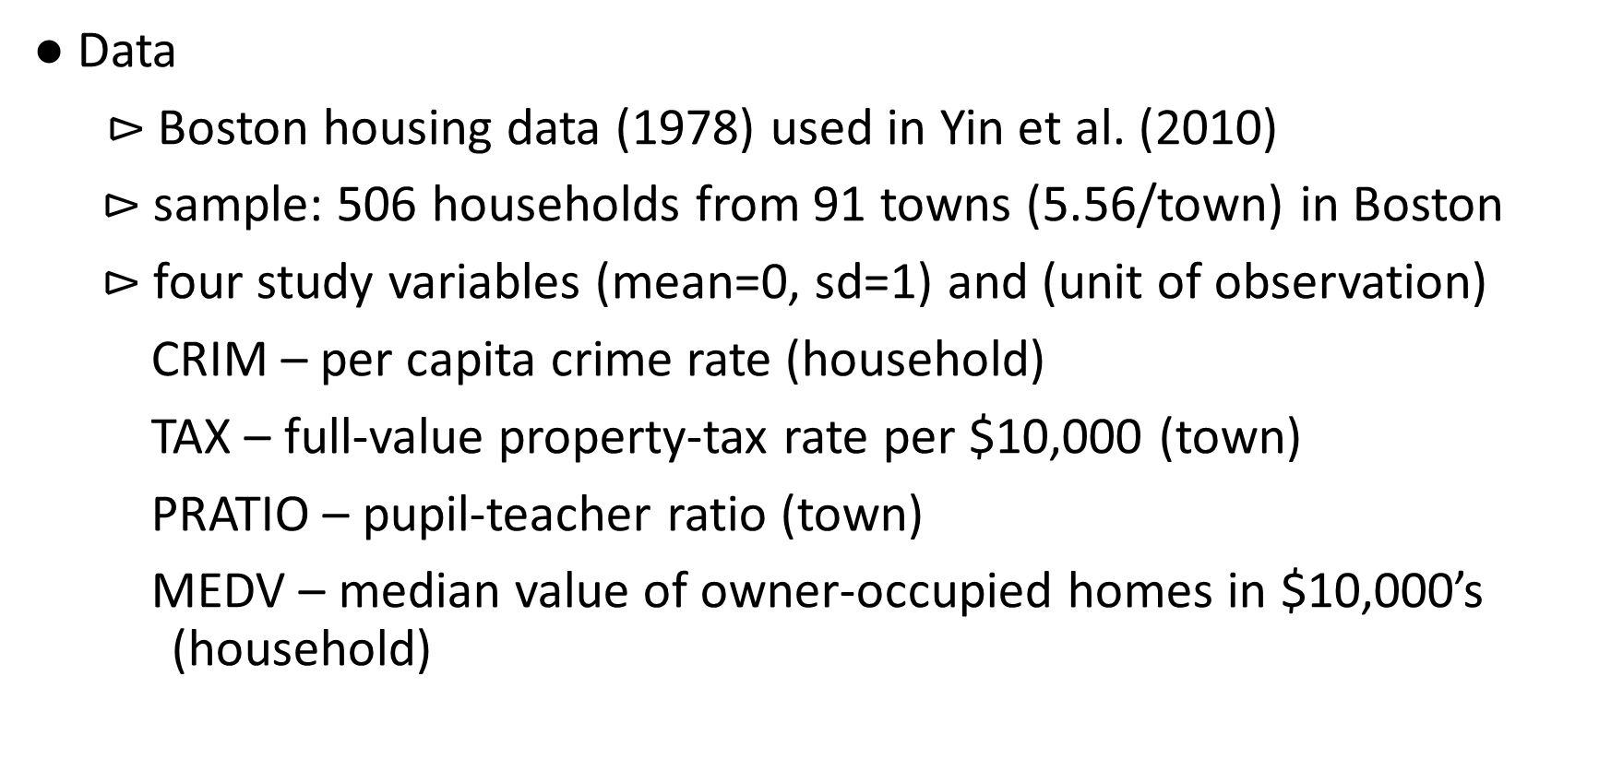
IV. Application to Real Data
● Data
⊳ Boston housing data (1978) used in Yin et al. (2010)
$⊳$ sample: 506 households from 91 towns (5.56/town) in Boston
$⊳$ four study variables (mean=0, sd=1) and (unit of observation)
CRIM – per capita crime rate (household)
TAX – full-value property-tax rate per $10,000 (town)
PRATIO – pupil-teacher ratio (town)
MEDV – median value of owner-occupied homes in $10,000’s (household)

Slide 19
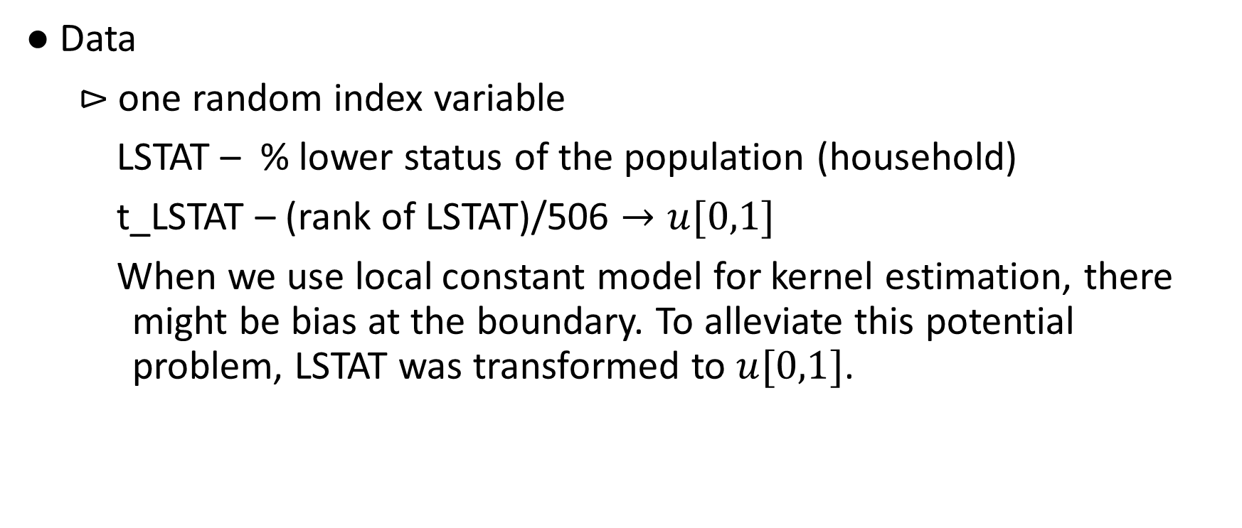
IV. Application to Real Data
● Data
$⊳$ one random index variable
LSTAT – % lower status of the population (household)
t_LSTAT – (rank of LSTAT)/506 $→u[0,1]$
When we use local constant model for kernel estimation, there might be bias at the boundary. To alleviate this potential problem, LSTAT was transformed to $u[0,1]$.

Slide 20
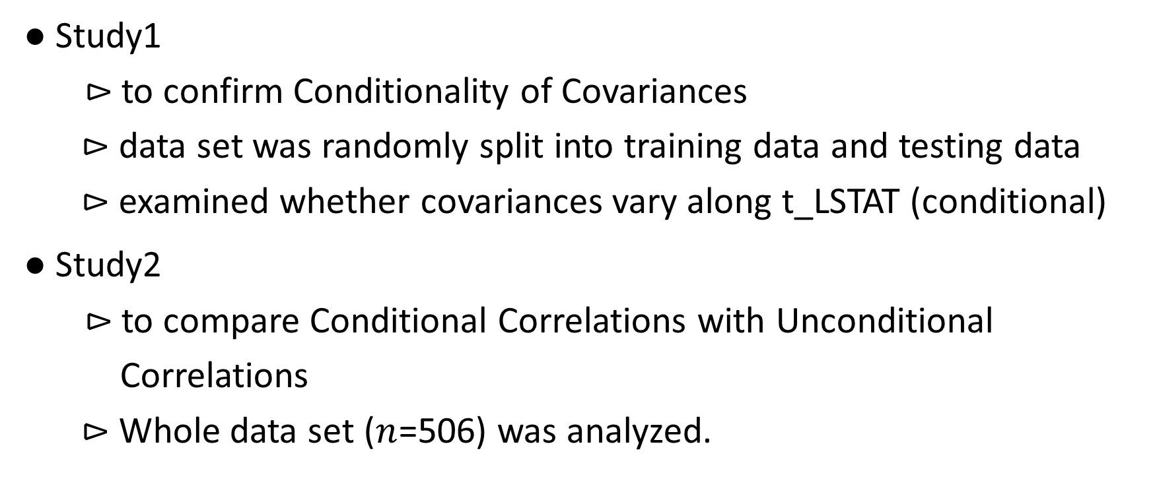
IV. Application to Real Data
● Study1
⊳ to confirm Conditionality of Covariances
$⊳$ data set was randomly split into training data and testing data
$⊳$ examined whether covariances vary along t_LSTAT (conditional)
● Study2
⊳ to compare Conditional Correlations with Unconditional
Correlations
$⊳$ Whole data set ($n$=506) was analyzed.

Slide 21
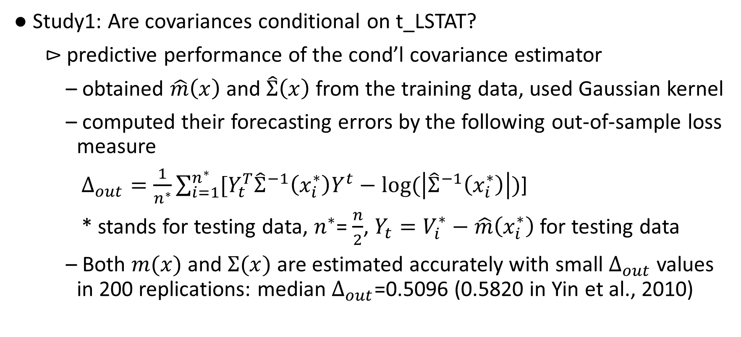
IV. Application to Real Data
● Study1: Are covariances conditional on t_LSTAT?
$⊳$ predictive performance of the cond’l covariance estimator
– obtained $\hat{m}\left(x\right)$ and $\hat{Σ}\left(x\right)$ from the training data, used Gaussian kernel
– computed their forecasting errors by the following out-of-sample loss measure
$Δ_{out}=\frac{1}{n^{∗}}\sum_{i=1}^{n^{∗}}{[Y_{t}^{T}{\hat{Σ}}^{−1}\left(x_{i}^{∗}\right)Y^{t}−log⁡(\left|{\hat{Σ}}^{−1}\left(x_{i}^{∗}\right)\right|)\text{]}}$
* stands for testing data, $n^{∗}$= $\frac{n}{2}$, $Y_{t}=V_{i}^{∗}−\hat{m}\left(x_{i}^{∗}\right)$ for testing data
– Both $m(x)$ and $Σ(x)$ are estimated accurately with small $Δ_{out}$ values in 200 replications: median $Δ_{out}$=0.5096 (0.5820 in Yin et al., 2010)

Slide 22
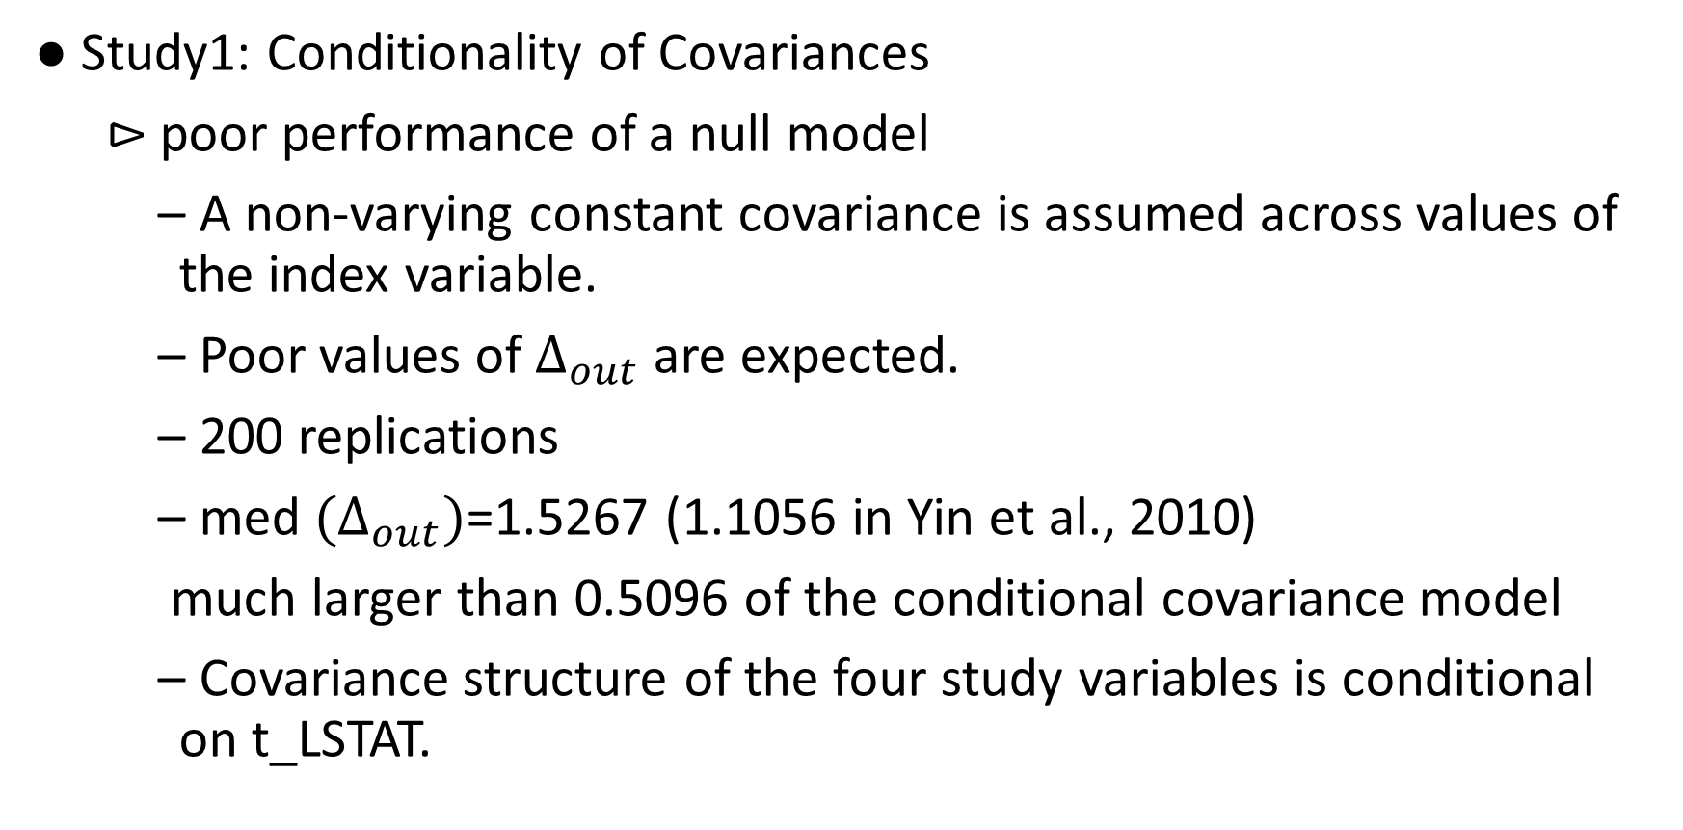
IV. Application to Real Data
● Study1: Conditionality of Covariances
$⊳$ poor performance of a null model
– A non-varying constant covariance is assumed across values of the index variable.
– Poor values of $Δ_{out}$ are expected.
– 200 replications
– med ${(Δ}_{out})$=1.5267 (1.1056 in Yin et al., 2010)
much larger than 0.5096 of the conditional covariance model
– Covariance structure of the four study variables is conditional on t_LSTAT.

Slide 23
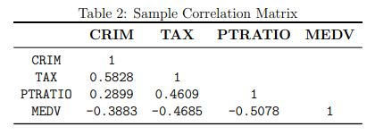

IV. Application to Real Data
● Study2: Comparison of Conditional and Unconditional Correlations
$⊳$unconditional correlations (sample correlations)

Slide 24
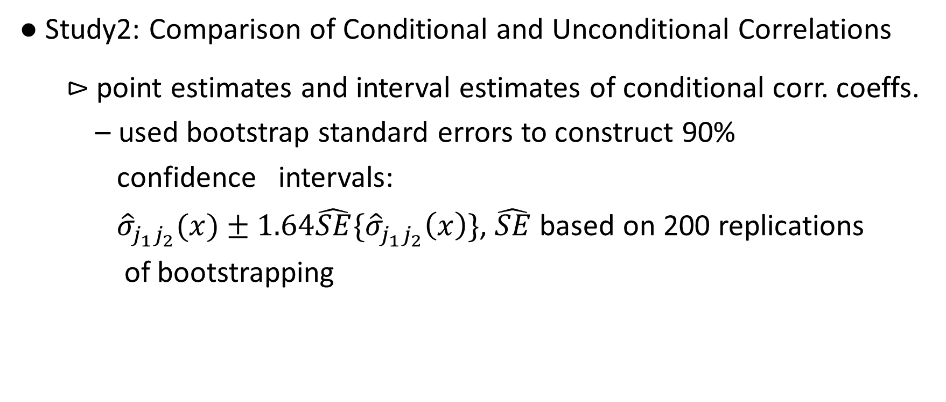
IV. Application to Real Data
● Study2: Comparison of Conditional and Unconditional Correlations
$⊳$point estimates and interval estimates of conditional corr. coeffs.
– used bootstrap standard errors to construct 90%
confidence intervals:
${\hat{σ}}_{j_{1}j_{2}}(x)±1.64\hat{SE}\{{\hat{σ}}_{j_{1}j_{2}}\left(x\right)\}$, $\hat{SE}$ based on 200 replications
of bootstrapping

Slide 25
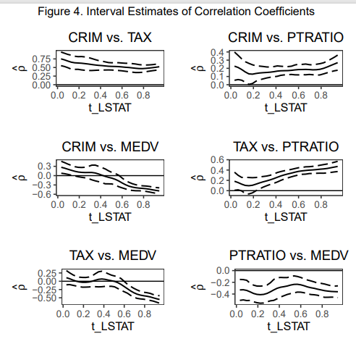
IV. Application to Real Data
● Study2: Comparison of Conditional and Unconditional Correlations

Slide 26
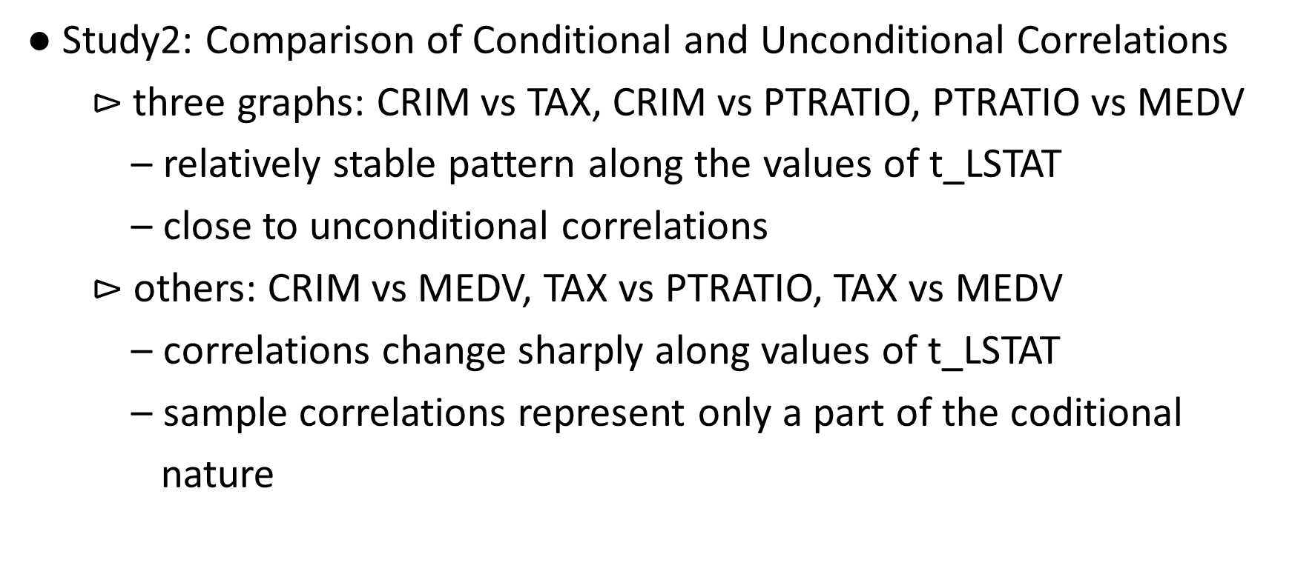
IV. Application to Real Data
● Study2: Comparison of Conditional and Unconditional Correlations
$⊳$three graphs: CRIM vs TAX, CRIM vs PTRATIO, PTRATIO vs MEDV
– relatively stable pattern along the values of t_LSTAT
– close to unconditional correlations
$⊳$ others: CRIM vs MEDV, TAX vs PTRATIO, TAX vs MEDV
– correlations change sharply along values of t_LSTAT
– sample correlations represent only a part of the coditional
nature

Slide 27
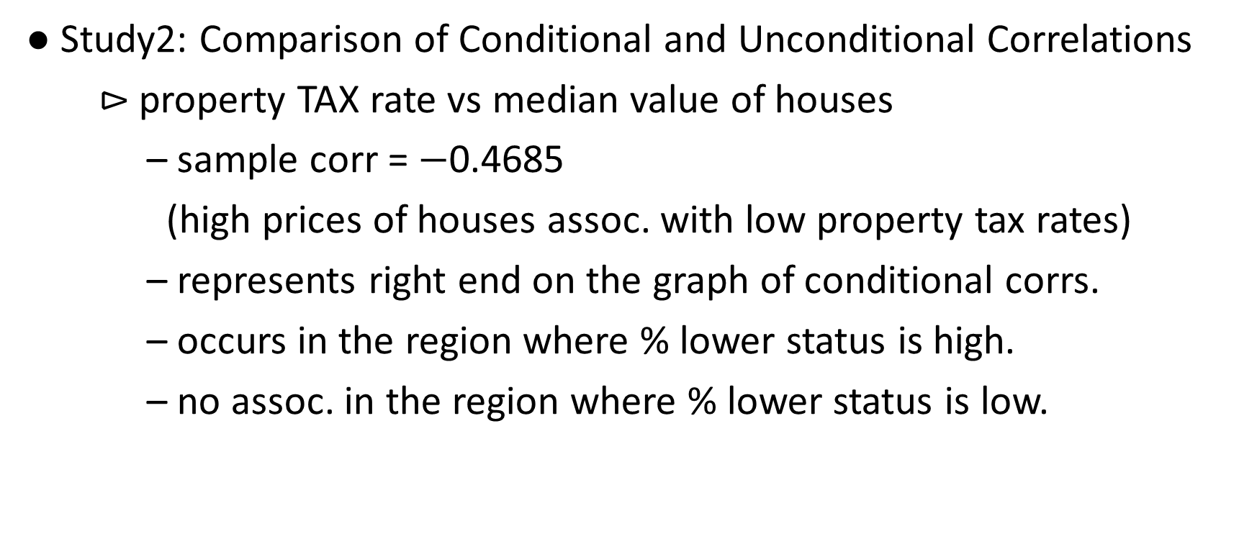
IV. Application to Real Data
● Study2: Comparison of Conditional and Unconditional Correlations
$⊳$ property TAX rate vs median value of houses
– sample corr = $−$0.4685
(high prices of houses assoc. with low property tax rates)
– represents right end on the graph of conditional corrs.
– occurs in the region where % lower status is high.
– no assoc. in the region where % lower status is low.

Slide 28
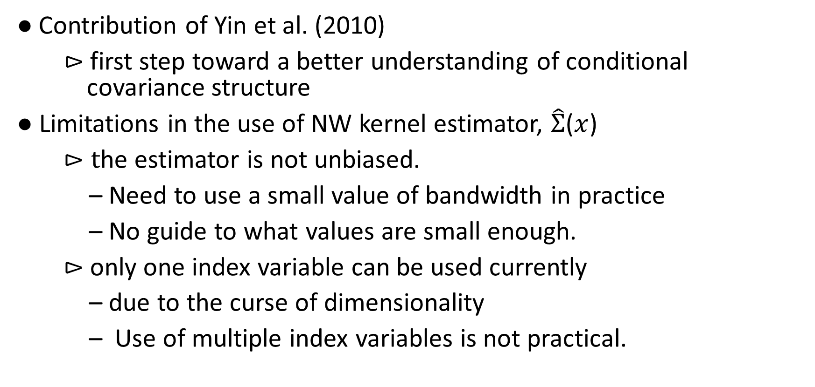
V. Conclusion
$\text{●}$Contribution of Yin et al. (2010)
$⊳$first step toward a better understanding of conditional covariance structure
● Limitations in the use of NW kernel estimator, $\hat{Σ}$($x$)
$⊳t$he estimator is not unbiased.
– Need to use a small value of bandwidth in practice
– No guide to what values are small enough.
$⊳$ only one index variable can be used currently
– due to the curse of dimensionality
– Use of multiple index variables is not practical.

Slide 29
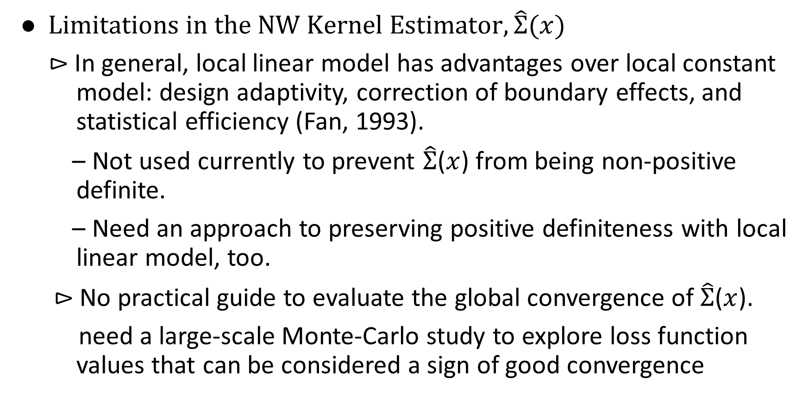
V. Conclusion
$$\text{●} Limitations in the NW Kernel Estimator, \hat{Σ}(x)$$
$⊳$ In general, local linear model has advantages over local constant model: design adaptivity, correction of boundary effects, and statistical efficiency (Fan, 1993).
– Not used currently to prevent $\hat{Σ}$($x$) from being non-positive definite.
– Need an approach to preserving positive definiteness with local linear model, too.
$⊳$ No practical guide to evaluate the global convergence of $\hat{Σ}$($x$).
need a large-scale Monte-Carlo study to explore loss function values that can be considered a sign of good convergence

Slide 30
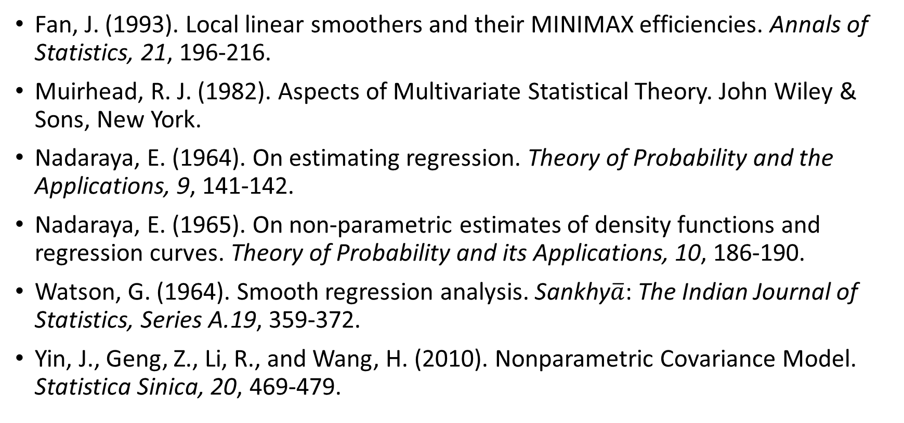
Reference
Fan, J. (1993). Local linear smoothers and their MINIMAX efficiencies. Annals of Statistics, 21, 196-216.
Muirhead, R. J. (1982). Aspects of Multivariate Statistical Theory. John Wiley & Sons, New York.
Nadaraya, E. (1964). On estimating regression. Theory of Probability and the Applications, 9, 141-142.
Nadaraya, E. (1965). On non-parametric estimates of density functions and regression curves. Theory of Probability and its Applications, 10, 186-190.
Watson, G. (1964). Smooth regression analysis. Sankhy$\overline{a}$: The Indian Journal of Statistics, Series A.19, 359-372.
Yin, J., Geng, Z., Li, R., and Wang, H. (2010). Nonparametric Covariance Model. Statistica Sinica, 20, 469-479.

Slide 31
Thank You !!!

